Slide 1
Message passing system
Chapter - 1 (1.5,1.6,1.7) -Distributed Computing - Kshemkalyani

Slide 2
Message-passing systems versus shared memory systems
DSM | MPI
Shared memory region is used for communication. | Message passing facility is used for communication.
It is used for communication between processes on a single processor or multiprocessor systems where the communicating processes reside on the same machine as the communicating processes share a common address space. | It is typically used in a distributed environment where communicating processes reside on remote machines connected through a network.
The code for reading and writing the data from the shared memory should be written explicitly by the Application programmer. | No such code required here as the message passing facility provides mechanism for communication and synchronization of actions performed by the communicating processes.
It provides maximum speed of computation as communication is done through shared memory so system calls are made only to establish the shared memory. | It is time consuming as message passing is implemented through kernel intervention (system calls).
Here the processes need to ensure that they are not writing to the same location simultaneously. | It is useful for sharing small amounts of data as conflicts need not to be resolved.
Faster communication strategy. | Relatively slower communication strategy

Slide 3
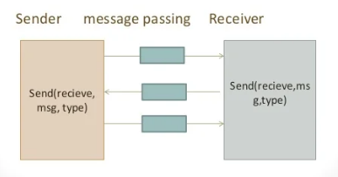
Emulating message-passing on a shared memory system (MP →SM)
The shared address space can be partitioned into disjoint parts for each processor.
“Send” and “receive” operations - implemented by writing to and reading from the destination/sender processor’s address space, respectively.
Specifically, a separate location can be reserved as the mailbox for each ordered pair of processes.
A P1–P2 message-passing can be emulated by a write by P1 to the mailbox and then a read by P1 from the mailbox.
In the simplest case, these mailboxes can be assumed to have unbounded size.
The write and read operations need to be controlled using synchronization primitives to inform the receiver/sender after the data has been sent/received.

Slide 4
Emulating shared memory on a message-passing system (SM →MP)
This involves the use of “send” and “receive” operations for “write” and “read” operations.
Each shared location can be modeled as a separate process
“write” to a shared location is emulated by sending an update message to the corresponding owner process
“read” to a shared location is emulated by sending a query message to the owner process.

Slide 5
Primitives for distributed communication
Blocking/non-blocking, synchronous/asynchronous primitives
Message send and message receive communication primitives are denoted Send() and Receive.
Send primitive has at least two parameters(), the destination, and the buffer in the user space, containing the data to be sent.
Receive primitive has at least two parameters – the source from which the data is to be received, and the user buffer into which the data is to be received.
Two ways of sending data
when the Send primitive is invoked – the buffered option and the unbuffered option.
buffered option - the standard option copies the data from the user buffer to the kernel buffer- The data later gets copied from the kernel buffer onto the network.
unbuffered option- the data gets copied directly from the user buffer onto the network.
For the Receive primitive, the buffered option is usually required because the data may already have arrived when the primitive is invoked, and needs a storage place in the kernel.

Slide 6
Blocking/non-blocking and synchronous/ asynchronous primitives
Synchronous primitives
A Send or a Receive primitive is synchronous if both the Send() and Receive() handshake with each other.
The processing for the Send primitive completes only after the invoking processor learns that the other corresponding Receive primitive has also been invoked and that the receive operation has been completed.
The processing for the Receive primitive completes when the data to be received is copied into the receiver’s user buffer.
Asynchronous primitives
A Send primitive is said to be asynchronous if control returns back to the invoking process after the data item to be sent has been copied out of the user-specified buffer.
It does not make sense to define asynchronous Receive primitives.
Blocking primitives
A primitive is blocking if control returns to the invoking process after the processing for the primitive (whether in synchronous or asynchronous mode) completes.
Non-blocking primitives
A primitive is non-blocking if control returns back to the invoking process immediately after invocation, even though the operation has not completed.
For a non-blocking Send, control returns to the process even before the data is copied out of the user buffer.
For a non-blocking Receive, control returns to the process even before the data may have arrived from the sender.

Slide 7
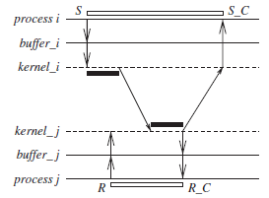
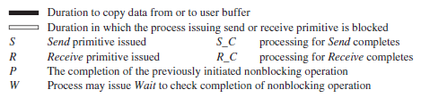
Blocking synchronous Send
The data gets copied from the user buffer to the kernel buffer and is then sent over the network.
After the data is copied to the receiver’s system buffer and a Receive call has been issued, an acknowledgement back to the sender causes control to return to the process that invoked the Send operation and completes the Send.

Slide 8
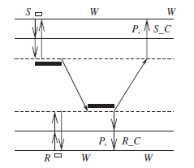
non-blocking synchronous Send
Control returns back to the invoking process as soon as the copy of data from the user buffer to the kernel buffer is initiated.
A parameter in the non-blocking call also gets set with the handle of a location that the user process can later check for the completion of the synchronous send operation.
The location gets posted after an acknowledgement returns from the receiver, as per the semantics.
The user process can keep checking for the completion of the non-blocking synchronous Send by testing the returned handle, or it can invoke the blocking Wait operation on the returned handle.

Slide 9
Blocking Receive & non-blocking Receive
The Receive call blocks until the data expected arrives and is written in the specified user buffer. Then control is returned to the user process.
The Receive call will cause the kernel to register the call and return the handle of a location that the user process can later check for the completion of the non-blocking Receive operation.
This location gets posted by the kernel after the expected data arrives and is copied to the user-specified buffer.
The user process can check for the completion of the non-blocking Receive by invoking the Wait operation on the returned handle.

Slide 10
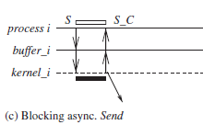
Blocking asynchronous Send
The user process that invokes the Send is blocked until the data is copied from the user’s buffer to the kernel buffer.

Slide 11
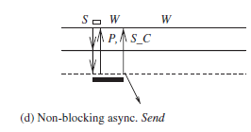
non-blocking asynchronous Send
The user process that invokes the Send is blocked until the transfer of the data from the user’s buffer to the kernel buffer is initiated.
Control returns to the user process as soon as this transfer is initiated, and a parameter in the non-blocking call also gets set with the handle of a location that the user process can check later using the Wait operation for the completion of the asynchronous Send operation.
The asynchronous Send completes when the data has been copied out of the user’s buffer. The checking for the completion may be necessary if the user wants to reuse the buffer from which the data was sent.

Slide 12
Synchronous executions
Asynchronous executions
processors are synchronized and the clock drift rate between any two processors is bounded,
message delivery (transmission + delivery) times are such that they occur in one logical step or round
there is a known upper bound on the time taken by a process to execute a step.
When implementing this abstraction, observe that the fewer the steps or “synchronizations” of the processors, the lower the delays and costs.
If processors are allowed to have an asynchronous execution for a period of time and then they synchronize, then the granularity of the synchrony is coarse.
This is really a virtually synchronous execution, and the abstraction is sometimes termed as virtual synchrony.
there is no processor synchrony and there is no bound on the drift rate of processor clocks
message delays (transmission + propagation times) are finite but unbounded
there is no upper bound on the time taken by a process to execute a step.
An example asynchronous execution with four processes P0 to P3
The arrows denote the messages;
the tail and head of an arrow mark the send and receive event for that message, denoted by a circle and vertical line, respectively.
Non-communication events, also termed as internal events, are shown by shaded circles.

